Slide 1
Analysis of Golden and Death Crosses in Stock Prices
Notes:
Good Morning Everyone. By the end of this presentation, we hope to provide valuable insights into how golden and death crosses might influence investment strategies.

Slide 2
Overview
Daily Moving Average
Understanding Golden and Death Crosses
Dataset and Methodology
Golden Cross Analysis
Death Cross Analysis
Comparative Analysis
Conclusion and Takeaways
Notes:
We'll start with a brief overview of technical analysis and the role of moving averages. Following that, we'll define golden and death crosses, describe our methodology for identifying these crosses in historical stock price data, and present our findings on their impact on stock prices. Finally, we'll discuss the implications of our analysis for investors and conclude with our recommendations based on the data.

Slide 3
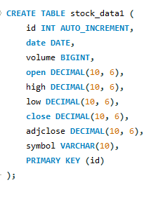
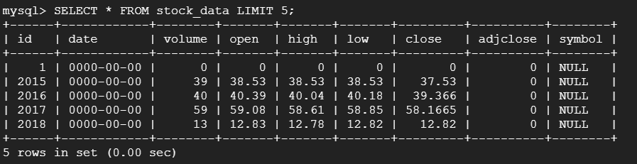
Importing Data To Cloud SQL Database
We have the stock data in Cloud Bucket
Created a sql instance stocks-database
Created a new table for our stocks database
Imported Data from Google cloud bucket
Notes:
Befor that we have Imported our kaggle dataset to SQL Database. We have created a google cloud bucket first, We put all the data fro out instance to cloud bucket using gsutil cp command. We have created a sql instance after that. For some reason We are not able to create new table in cloud shell so we have used workbench to create a table for our stock prices csv. And then we imported the data from google cloud bucket.

Slide 4
Daily Moving Average
A daily moving average (DMA) is a tool in technical analysis that smooths out price fluctuations by averaging closing prices over a set number of trading days. Daily moving averages are commonly used to identify trends and potential support or resistance levels in price charts. It helps traders see the overall trend by filtering out short-term price movements.
Notes:
A DMA is calculated by taking the average of a stock's closing prices over a set number of days. By doing so, it smooths out the volatility inherent in daily trading and helps us visualize a clearer trend

Slide 5
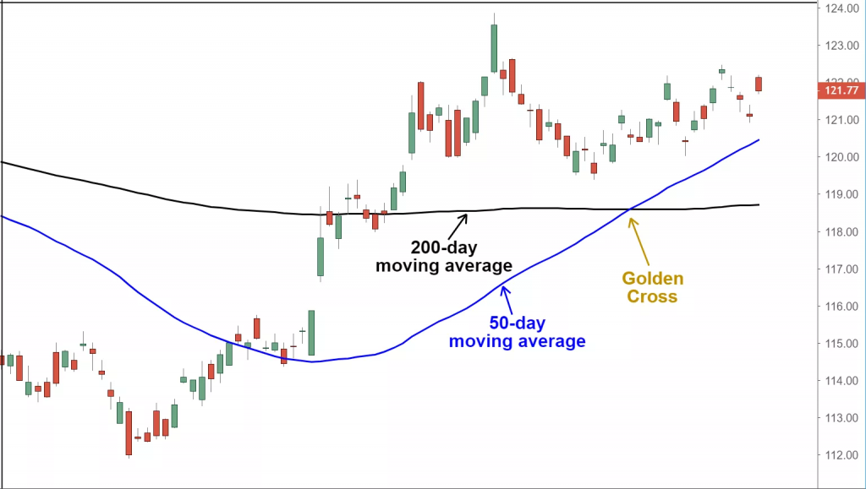
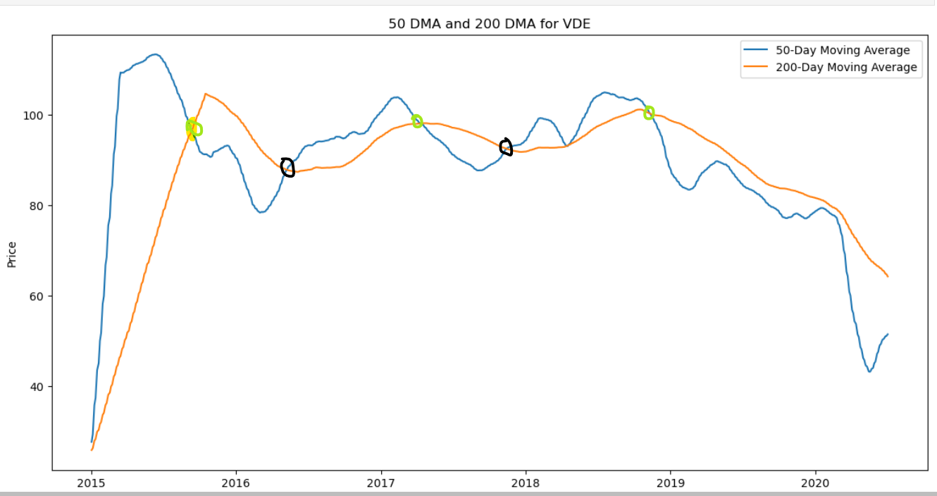
What are Golden and Death crosses
Notes:
when the shorter-term, 50-day moving average, shown here in blue, crosses above the longer-term, 200-day moving average, the black line. This is considered a bullish signal by traders, suggesting that a stock is gaining momentum and could be on the cusp of an uptrend.

Slide 6
Methodology
Data Collection
Data Preprocessing
Calculating Moving Averages
Source: 5 Years
Period: 5 years
Cleaning Missing/Incomplete Data
Converting Data Types
Sorting the Data
Computing 50-day Moving Average
Computing 200 Day Moving Average
1
2
3

Slide 7
Identifying Crosses
Analysing Price Movements
Overall Comparison
Identify Golden Crosses
Identify Death Crosses
Track price Changes
Time Frames: 1 week to 6 months
4
5
6

Slide 8
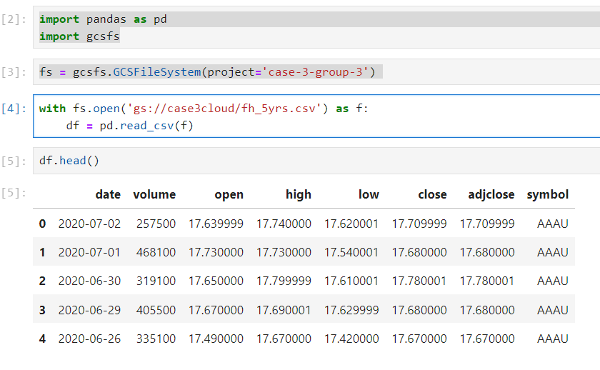
Importing Data from Google cloud Bucket
Notes:
This slide initiates the discussion by highlighting the process of importing data critical for analyzing Golden and Death Crosses in stock prices. It elaborates on the sources from which historical stock price data was retrieved, including financial databases and stock market feeds. The slide emphasizes the selection criteria for data, ensuring the inclusion of stocks with sufficient history for a robust analysis of their price movements in relation to Golden and Death Cross occurrences.

Slide 9
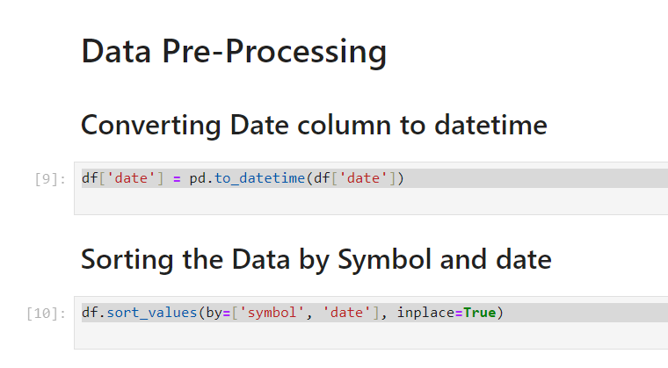
Notes:
This slide covers two key steps in our analysis. First, we talk about cleaning up the stock data. We fixed any errors and made sure everything was consistent, so our analysis would be accurate. Then, we moved on to plotting moving averages. This means we calculated and drew lines on a chart to show the average stock prices over different periods. These steps were crucial for spotting the Golden and Death Crosses in the data, helping us see how these indicators might predict changes in stock prices. It's about getting our data right and then using it to look for patterns.

Slide 10
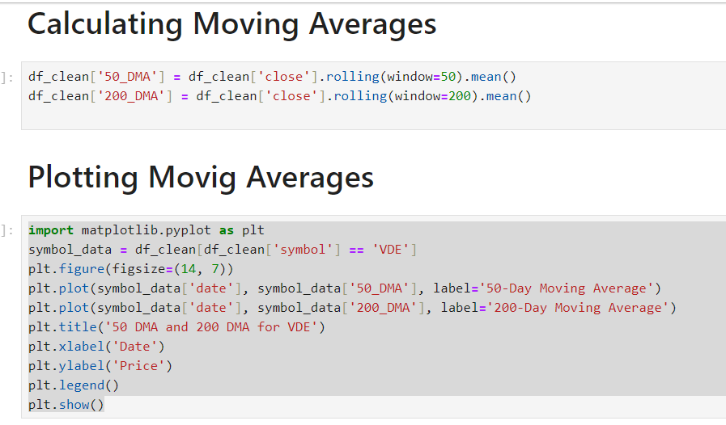
Notes:
This slide talks about how we used moving averages in our study. First, we figured out the moving averages, which means we took the average stock prices over certain periods to make the trends easier to see. Then, we drew these averages on graphs. This helps us spot the Golden and Death Crosses by showing us when the short-term trend crosses over the long-term trend. It's a key step to understand potential ups and downs in stock prices.

Slide 11
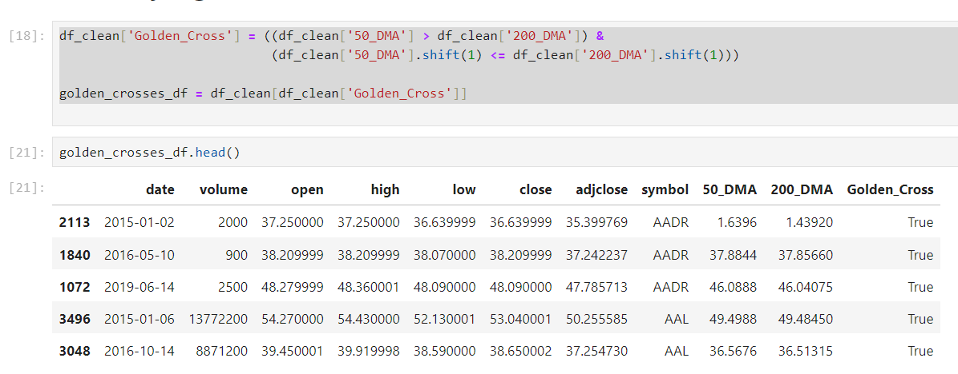
Identifying Golden Crosses

Slide 12
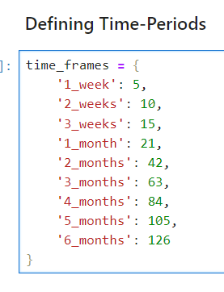
What percentage of those golden crosses result in a price increase by more than 5%, 10%, 15%, 20%, 25% over a week, two weeks, three weeks, a month, two months, three months, four months, five months, six months?

Slide 13
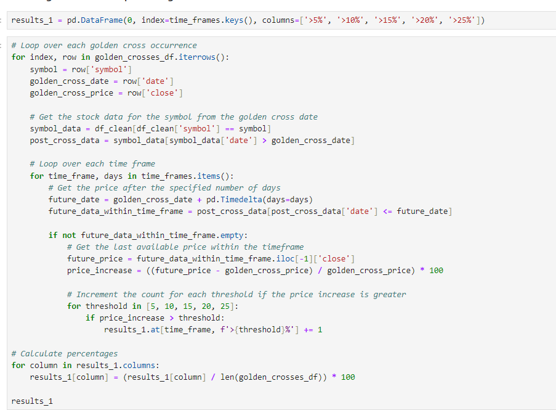
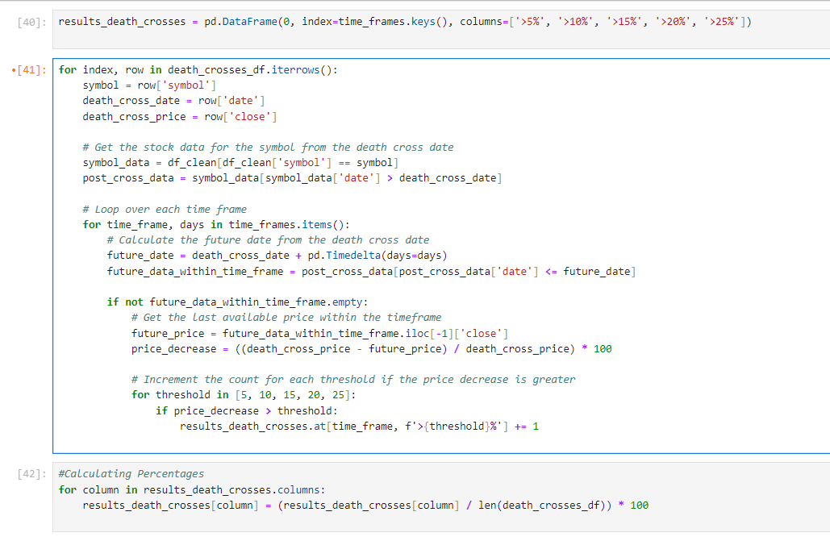
Looping over Golden crosses and Time frames
Notes:
wE ITERATE THROUH EVERY DEATH CROSS IDENTIFIED IN OUR DATA. FOR EACH DEATH CROSS WE CAPTURE stock's symbol, the date it occurred, and the closing price at that time. Once we have identified a death cross for a particular stock,We extract the stock data starting just after the death cross date to monitor the subsequent price changes. Our analysis is not just short-term. We evaluate the stock's performance across multiple time frames — from one week up to six months. For each time frame, we calculate the price decrease percentage. We compare the closing price at the death cross with the closing price at the end of the time frame to determine how much the stock price has decreased. Finally, our results_death_crosses DataFrame accumulates these findings. It allows us to summarize the frequency of occurrences where the price decrease after a death cross surpasses our defined thresholds.

Slide 14
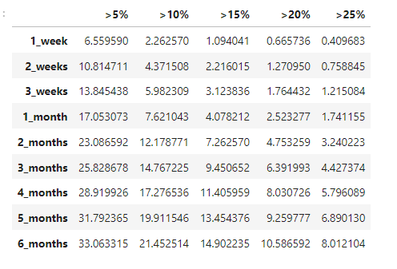
Percentage of price increases over time
This trend seems to support the hypothesis that a golden cross is a bullish signal, suggesting that prices tend to rise after such a cross.
Notes:
the likelihood of a price increase greater than 5% is around 33%, and for increases over 25%, it's about 8%.

Slide 15
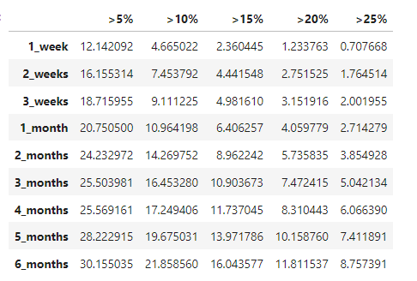
Percentage of price decreases over time
The data also supports the death cross hypothesis as a bearish indicator. The likelihood of price decreases following death crosses appears to be significant, especially over longer time frames.
Notes:
wE ITERATE THROUH EVERY DEATH CROSS IDENTIFIED IN OUR DATA. FOR EACH DEATH CROSS WE CAPTURE stock's symbol, the date it occurred, and the closing price at that time. Once we have identified a death cross for a particular stock,We extract the stock data starting just after the death cross date to monitor the subsequent price changes. Our analysis is not just short-term. We evaluate the stock's performance across multiple time frames — from one week up to six months. For each time frame, we calculate the price decrease percentage. We compare the closing price at the death cross with the closing price at the end of the time frame to determine how much the stock price has decreased. Finally, our results_death_crosses DataFrame accumulates these findings. It allows us to summarize the frequency of occurrences where the price decrease after a death cross surpasses our defined thresholds.

Slide 16
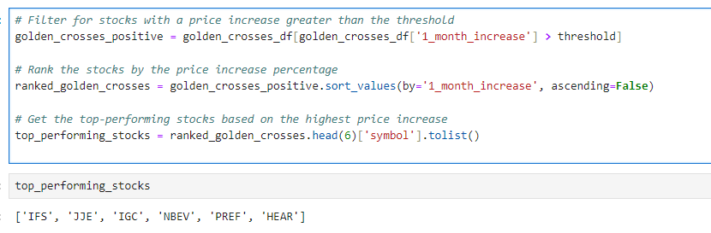
Potential Stocks to buy and hold
Notes:
After conducting our analysis on golden crosses, we identified six stocks that show promise for a buy-and-hold strategy over the next month.These stocks have exhibited significant price increases following a golden cross

Slide 17
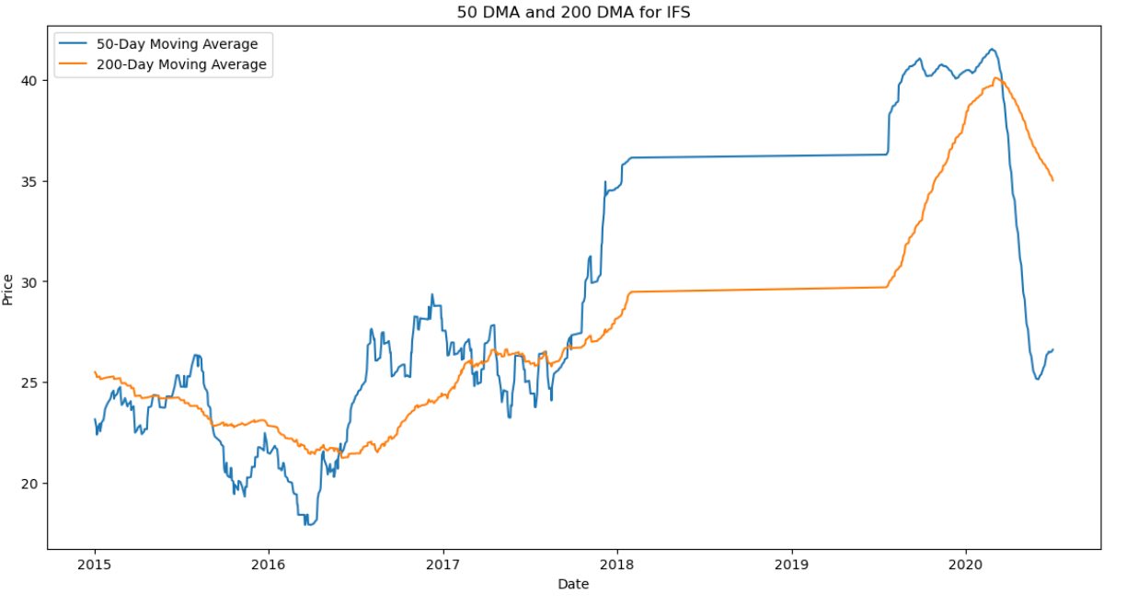
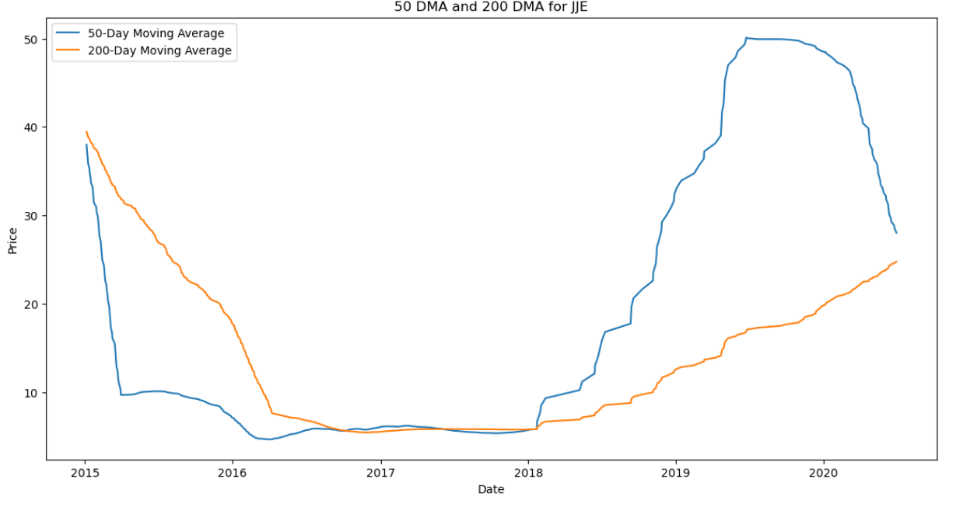
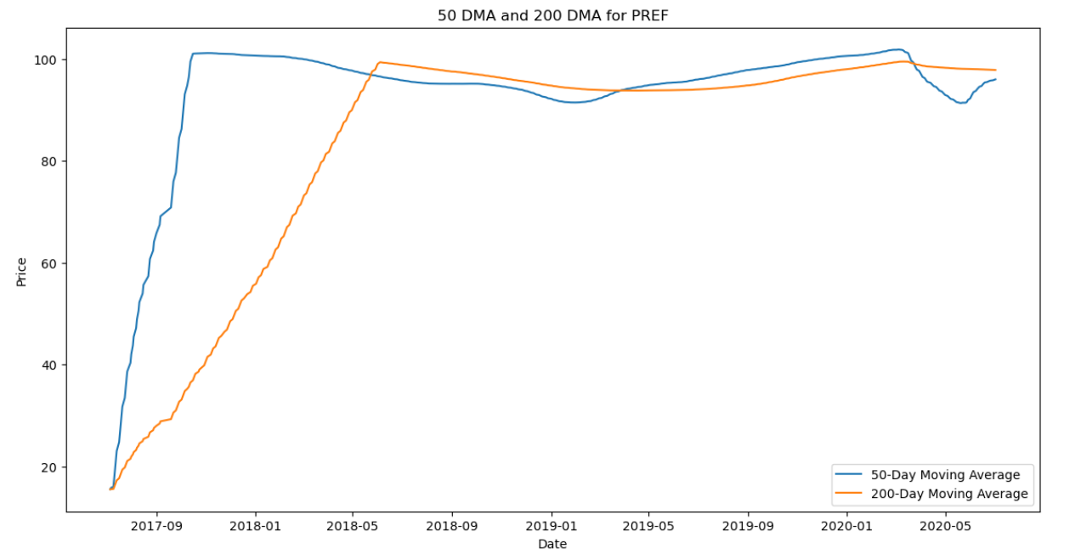
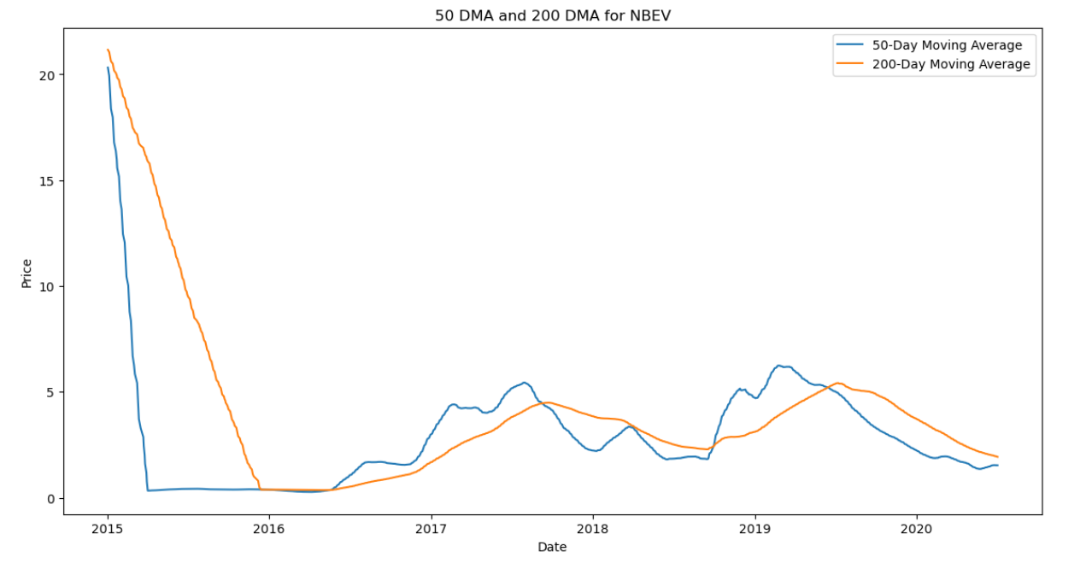
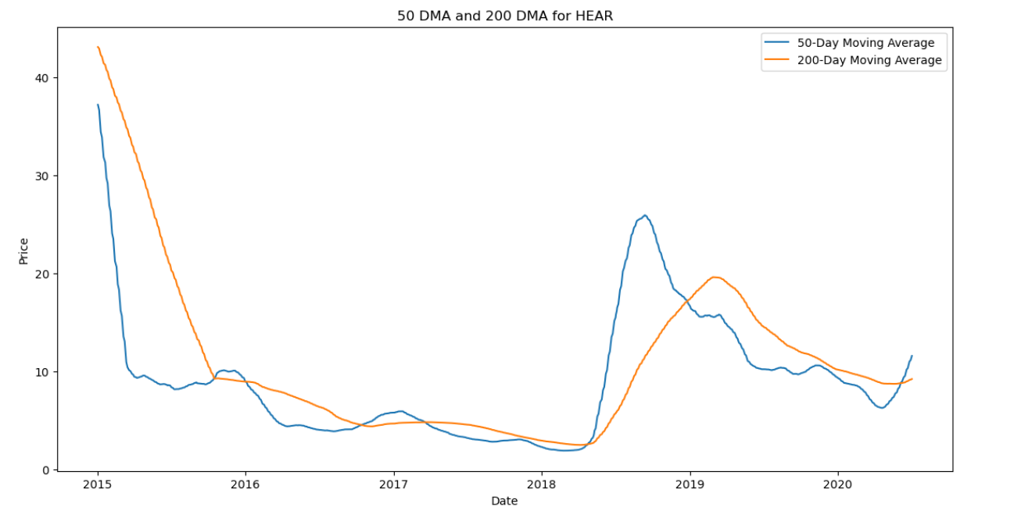
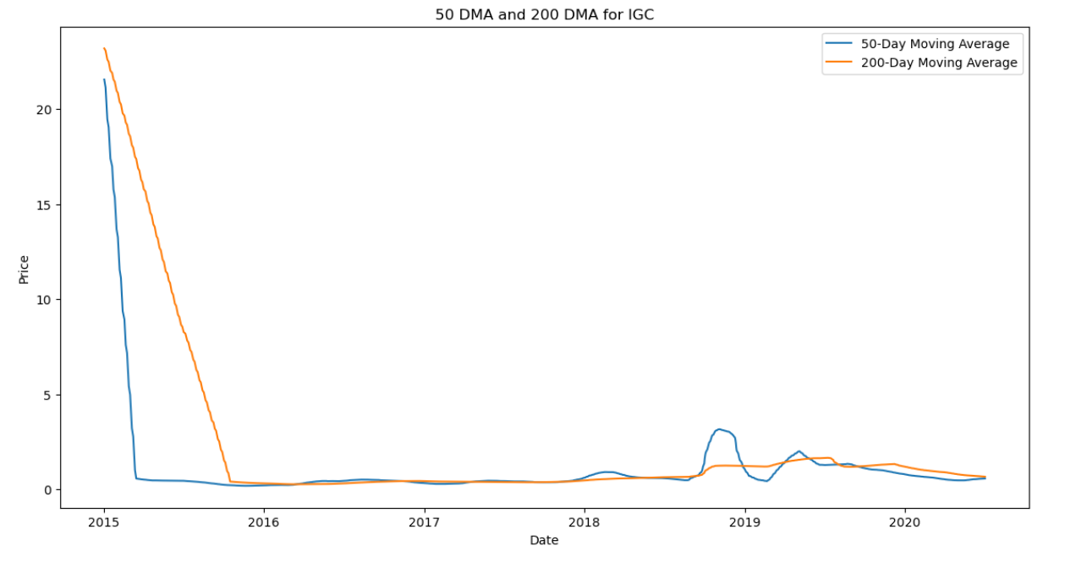
Notes:
As we look at these graphs, notice the points at which the blue line—the 50-day moving average—crosses above the orange line—the 200-day moving average.

Slide 18
Challenges we faced working on the code
Technical Limitations:
Processing power
SSH Troubleshoot error
Computational Efficiency
Taking over two hours to run

Slide 19
Overall Comparison
Bullish vs. Bearish Sentiment: The data confirms the expected bullish sentiment after Golden Crosses and bearish sentiment after Death Crosses in the market.
Magnitude of Movements: Golden Crosses tend to lead to larger percentage increases in stock prices compared to the percentage decreases observed after Death Crosses.
Duration Matters: The analysis highlights the importance of considering the duration after cross events, with longer time frames generally associated with more significant price movements.
Trading Strategy Considerations: Traders and investors can utilize this information to adjust their trading strategies, such as holding positions longer after Golden Crosses and being cautious of potential downward trends after Death Crosses, to optimize portfolio performance and manage risk effectively.

